Slide 1

STEM and the Revised Medical College Admission Test (MCAT)
Chicago Symposium
January 30, 2015
Robert Hilborn
American Association of Physics Teachers

Slide 2
Outline
Educational ecology
Background and history
Conceptual framework for the new exam
STEM in the revised MCAT
Implications for undergraduate curricula
Discussion

Slide 3

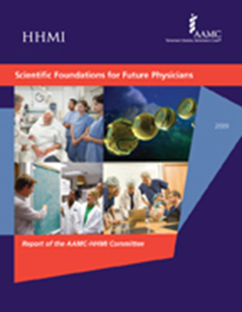
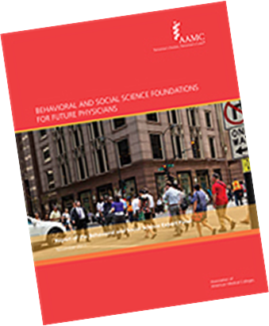
The blueprints for the MCAT²⁰¹⁵ exam are based on evidence
Roadmap to Diversity: Integrating Holistic Review Practices
    Scientific Foundations for Future Physicians Committee
    Behavioral and Social Sciences Foundations for Future Physicians
    Holistic Review Project Advisory Committee
Behavioral and Social Science Foundations for Future Physicians
Scientific Foundations for Future Physicians Report
Notes:
The MR5 committee was formed and began its work in 2008. the 21-member advisory board reviewed the current exam and planned the new exam.
It did a great deal of fact-finding soliciting input from several blue-ribbon and advisory committees, including about the knowledge and skills that are most important for entering medical students to know:
Scientific Foundations for Future Physicians Committee
Behavioral and Social Sciences Foundations for Future Physicians Expert Panel
As well as working closely with Holistic Review Project Advisory Committee
The MR5 committee developed recommendations for the new exam that were informed by the research conducted from 2008 to 2011. The committee recommended that the new test preserve what works best, eliminate what doesn’t, enrich the new exam with concepts that future physicians are likely to need, and use a testing format that has proven successful.

Slide 4
Conceptual Framework:
Preparing for Medical School
Natural Sci.
Preparation - SFFP
Behavioral Sci.
Preparation
General Academic,
Social, and Personal Preparation
MCAT
4

Slide 5
How did we get here?

Slide 6
A Comment on American
Higher Education
Lectures enable colleges to "handle cheaply by wholesale a large body of students that would be otherwise unmanageable and thus give the lecturer time for research."

Slide 7
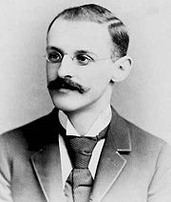
Abraham Flexner
The American College (1908)
Carnegie Foundation Report Number Four (1910)
AKA “The Flexner Report”
With Louis Bamberger, Flexner founded the Institute for Advanced Study in Princeton, heading it from 1930 to 1939
Notes:
In 1908, Flexner published his first book, The American College. Strongly critical of many aspects American higher education, it was especially critical of the university lecture as a method of instruction. According to Flexner, lectures enabled colleges to "handle cheaply by wholesale a large body of students that would be otherwise unmanageable and thus give the lecturer time for research."

Slide 8
The Flexner Report (1910)
Medical community should
Enact higher admissions standards (high school diploma and two years of college)
Adhere to strict principles of mainstream science in their teaching and research
Reduce the number of medical schools (from 155); nation was producing too many doctors

Slide 9
High Drop-out Rates in Medical Schools Led to
1928-1946
Scholastic Aptitude Test for Medical Students
1946 – present
Medical College Admission Test

Slide 10
The Scientific Foundations for Future Physicians Project
Initiated in 2007 and organized by
  Association of American Medical Colleges (AAMC)
  Howard Hughes Medical Institute (HHMI)
Committee:
  medical school faculty
  undergraduate science and math educators
Diverse institutions
MCAT leadership (a division of AAMC) closely involved

Slide 11
Structure of SFFP Recommendations
Overarching Principles
Competency (Medical or Entering) E1, E2, ….8
= broad statement of goal for knowledge and what you should be able to do with that knowledge
  Learning Objective 1, 2, etc
competencies in various topical areas
    Examples 1, 2, etc.

Slide 12
Competencies: E1 – E8
Apply quantitative reasoning and appropriate mathematics to describe or explain phenomena in the natural world
Demonstrate understanding of the process of scientific inquiry, and explain how scientific information is discovered and validated.
Demonstrate knowledge of basic physical principles and their applications to the understanding of living systems.
Demonstrate knowledge of basic principles of chemistry and some of their applications to the understanding of living systems.
Demonstrate knowledge of how bio-molecules contribute to the structure and function of cells.
Apply understanding of principles of how molecular and cell assemblies, organs, and organisms develop structure and carry out function.
Explain how organisms sense and control their internal environment and how they respond to external change.
Demonstrate an understanding of how the organizing principle of evolution by natural selection explains the diversity of life on earth.

Slide 13
Math and the SFFP E1
Demonstrate quantitative numeracy and facility with the language of mathematics
Interpret data sets and communicate those interpretations using visual and other appropriate tools.
Make statistical inferences from data sets.
Extract relevant information from large data sets.
Make inferences about natural phenomena using mathematical models.

Slide 14
Entering Med Student Competencies
Competency E1. Apply quantitative reasoning and appropriate mathematics to describe or explain phenomena in the natural world.
Learning Objectives:
  5. Make inferences about natural phenomena using mathematical models.
  Examples:
Describe the basic characteristics of models (e.g., multiplicative vs. additive).
Predict short- and long-term growth of populations (e.g., bacteria in culture).
Distinguish the role of indeterminacy in natural phenomena and the impact of stochastic factors (e.g., radioactive decay) from the role of deterministic processes.

Slide 15
Math and the SFFP E1
6. Apply algorithmic approaches and principles of logic (including the distinction between cause/effect and association) to problem solving.
7. Quantify and interpret changes in dynamical systems.
Examples of dynamical systems:
• Describe population growth using the language of exponents and of differential calculus.
• Explain homeostasis in terms of positive or negative feedback.
• Calculate return on investment under varying interest rates by utilizing appropriate mathematical tools.

Slide 16
Entering Med Student Competencies
Competency E3. Demonstrate knowledge of basic physical principles and their applications to the understanding of living systems
Learning Objectives:
Demonstrate understanding of mechanics as applied to human and diagnostic systems.
Demonstrate knowledge of the principles of electricity and magnetism (e.g., charge, current flow, resistance, capacitance, potential, and magnetic fields).
Demonstrate knowledge of wave generation and propagation to the production and transmission of light and sound.
Demonstrate knowledge of the principles of thermodynamics and fluid motion.
Demonstrate knowledge of principles of quantum physics such as atomic and molecular energy levels, spin, and ionizing radiation
Demonstrate knowledge of principles of systems behavior, including input–output relationships and positive and negative feedback.

Slide 17
Entering Med Student Competencies
Competency E3. Demonstrate knowledge of basic physical principles and their applications to the understanding of living systems
Learning Objective 3:
  Demonstrate knowledge of wave generation & propagation to the production and transmission of light, sound.
  Examples
Apply geometric optics to understand image formation in the eye.
Apply wave optics to understand the limits of image resolution in the eye.
Apply knowledge of sound waves to describe the use and limitations of ultrasound imaging.

Slide 18
Competency E4
Demonstrate knowledge of basic principles of chemistry and some of their applications to the understanding of living systems.

Slide 19
Learning Objective 6. Demonstrate knowledge of the chemistry of carbon-containing compounds relevant to their behavior in an aqueous environment.
Recognize major types of functional groups and chemical reactions.
Explain how molecular structure and geometry, including chirality, relate to chemical reactivity.
Explain the chemical principles that allow structural inference about bio-organic molecules based on common spectroscopic analyses, such as NMR, UV/visible/IR absorption, or X-ray diffraction.
Apply knowledge of the chemistry of covalent carbon compounds to explain biochemical reactions.

Slide 20
Competency E6 (Cell Biology)
Learning Objective 1
Employ knowledge of the general components of prokaryotic and eukaryotic cells, such as molecular, microscopic, macroscopic, and three-dimensional structure, to explain how different components contribute to cellular and organismal function.

Slide 21
Learning Objective E6.1
Examples:
Describe how the internal organization of a cell changes as it begins cell division.
Describe how proteins are targeted to different compartments in eukaryotic cells.
Describe the role of the cytoskeleton in amoeboid movement of cells.

Slide 22
The Revised MCAT
  MR5 (2010-2013) – 5th MCAT Review, 5th review since 1928
  Current exam was launched in 1991
  Gathered input at >90 outreach events
  Collected survey data from >2700 medical school and baccalaureate faculty, medical students, and residents
  Solicited input from blue-ribbon panels and advisory committees
  Revised MCAT launches on April 17, 2015.

Slide 23
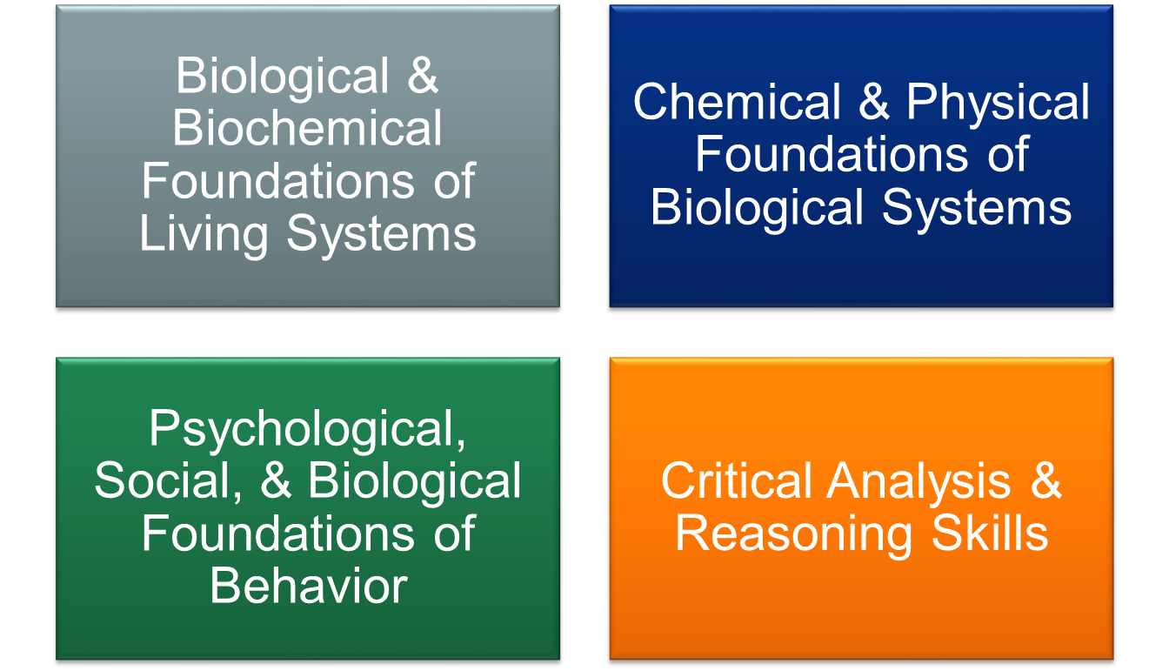
MCAT²⁰¹⁵ will test competencies in four areas
Notes:
The new exam will have 4 sections:
Biological and Biochemical Foundations of Living Systems
Chemical and Physical Foundations of Biological Systems
Psychological, Social, and Biological Foundations of Behavior
Critical Analysis and Reasoning Skills
The blueprints for the natural and behavioral sciences sections are organized around the competencies in the expert panel reports.

Slide 24
Conceptual framework for MCAT²⁰¹⁵
Matches medical schools’ shift to competency-based curricula
Increases emphasis on scientific and critical reasoning skills
Asks examinees to think like scientists by bringing together concepts in the natural and social sciences
And by reasoning about research designs and results and interpreting data and drawing conclusions

Slide 25
Chemical & Physical Foundations of Biological Systems
Foundational Concept 4
Content Categories
4A: Translational motion, forces, work, energy, and equilibrium in living systems
4B: Importance of fluids for the circulation of blood, gas movement, and gas exchange
4C: Electrochemistry and electrical circuits and their elements
4D: How light and sound interact with matter
4E: Atoms, nuclear decay, electronic structure, and atomic chemical behavior
Notes:
Foundational Concept 4 encompasses the idea that Complex living organisms transport materials, sense their environment, process signals, and respond to changes using processes that can be understood in terms of physical principles.

Slide 26
How are MCAT topics chosen?
Two Surveys:
Importance survey – medical school faculty, medical students, residents
What is taught survey – undergraduate natural science and social science faculty

Slide 27
Medical school faculty and students and undergraduate faculty survey data
  Content topics with high importance ratings that are widely taught will be tested on the future exam.
  Focus will be on using that content knowledge to reason about applications to living systems
  Some “straight content knowledge” questions will continue to appear on the MCAT

Slide 28
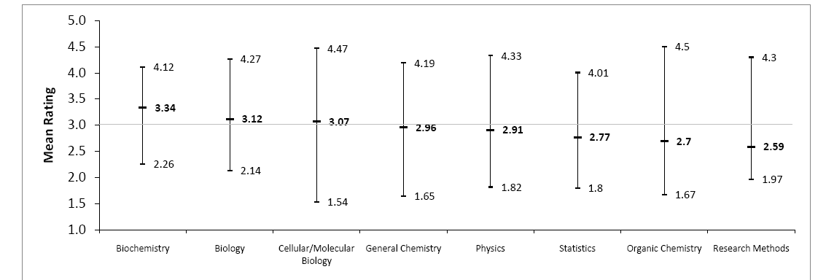
Science Importance Survey Results
Current MCAT cut-off

Slide 29
Physics Topics That Were Rated Very Highly
> 3.0
Units and dimensions
Mass, length, time, role of experiment and measurement
Error (uncertainty) analysis
Transport Processes – diffusion, osmosis, etc.
Graphing Techniques
Translational motion
Sound
Kinetic Theory and Ideal Gas Laws
Fluids
Circuit elements (batteries, capacitors, dielectrics, resistors,…)
Atomic Nucleus
Feedback and Control (descriptive)
Statistical Physics (statistical distributions, fluctuations and noise)
= 4.0 or higher (greater than any biochemistry topic)

Slide 30
Physics Topics with Relatively Low Importance Ratings < 2.5
Momentum
Rotational motion
Circuits (Kirchhoff’s Rules, Wheatstone bridge, potentiometer and voltage dividers, power in circuits)
Magnetism (magnetic materials, orbits of charged particles in magnetic fields, general sources of B fields)
Electromagnetic Induction
Alternating Current Circuits

Slide 31
Organic Chemistry Topics with Relatively Low Ratings < 2.5
Alkenes
Alkynes
Alkyl Halides
Dienes
Units of Unsaturation
Benzene and Aromatic Hydrocarbons
Arenes
Phenols
Ethers
Dicarboxylic Acids, Anhydrides, Imides
α, β-Unsaturated Carbonyl Compounds
1,3- β -dicarbonyl Compounds\
Other Nitrogen-Containing Compounds (Nitriles, Nitro, Azo, Lactams, Amides, Azides)
Sulfur Compounds
Organometallic Compounds

Slide 32
Scientific Inquiry & Reasoning Skills
These mirror SFFP entering medical student competencies 1 and 2
Tenets from other blue-ribbon reports include:
  AAAS Vision and Change Report
  Advanced Placement in Biology Content Outline
  Next Generation Science Standards
  Science Framework for the 2011 National Assessment of Educational Progress (NAEP)
Notes:
Note:
These mirror the SFFP entering medical student competencies 1 and 2
1=35%
2=45%
3=10%
4=10%

Slide 33




Scientific Inquiry & Reasoning Skills
Knowledge of Scientific Concepts & Principles
Scientific Reasoning and Problem Solving
Reasoning About the Design
and Execution of Research
Data-Based and Statistical Reasoning
Notes:
As mentioned earlier, The new MCAT exam will ask examinees to demonstrate that they can use their scientific knowledge. The revised MCAT exam asks examinees to solve problems by combining knowledge of the concepts described by the content categories with four scientific inquiry and reasoning skills. This means that each question on MAT2015 exam requires both knowledge of the content and demonstration of skills. Most of the MCAT2015 questions will ask examinees to reason about information presented in passages and many of those passages include graphs, tables, or charts.
We will talk about the 4 skills more in depth in a minute.

Slide 34
Mathematics and the Revised MCAT
No questions involving calculus. Only a few medical schools require students to have taken calculus.
Revised MCAT emphasizes (simple) statistical reasoning, modeling, analysis of data,….

Slide 35
How will the revised MCAT affect undergraduate curricula?

Slide 36
Challenges for Undergraduate Faculty
Devise a courses that help students meet the SFFP and other competencies
Sharpen the focus of undergraduate STEM courses for life science students: not everything in the standard STEM courses is relevant to life science students
Work with other STEM colleagues to streamline and focus the pre-health curriculum – investigate multi-disciplinary courses

Slide 37
Implications for STEM Courses
0th Approximation – make no changes
A Bit Better – physics and chemistry should include examples from life sciences and medicine – help students with transfer of knowledge (Ross’s talk)
  MCAT Guide: “Focus will be on using that content knowledge to reason about applications to living systems”
More biochemistry (ACS foundational level)
Use SFFP Competencies and Learning Objectives as a starting point for course design.

Slide 38
Implications for Introductory Physics for the Life Science Courses
Still Better
work with your local biologists
steal material from
Redish (Maryland)
Meredith (UNH)
Crouch (Swarthmore)
McKay (Michigan)
Donaldson (Rockhurst)
Beverly (Mercy)
…

Slide 39
Resources for examinees and faculty
Official Guide to the MCAT²⁰¹⁵
Full-length sample test to be taken online.
Online course-mapping tool for students and pre-health advisors
Khan Academy video tutorials
Pre-health Collection in MedEdPORTAL’s iCollaborative
Introductory Physics for the Life Sciences web site
http://www.compadre.org/ipls/
Notes:
There are several ways to learn about the new exam:

Slide 40
Discussion

